Slide 1
RESEARCH AGENT
CAPSTONE PROJECT
Presented By:
Abinash Sharma
College Name- Maharaja Sriram Chandra Bhanja Deo University,Baripada, Mayurbhanj, Odisha
Department Of Computer Application

Slide 2
OUTLINE
Problem Statement
Proposed System/Solution
System Development Approach (Technology Used)
Algorithm & Deployment
Result (Output Image)
Conclusion
Future Scope
References

Slide 3
Problem Statement
Research Agent The Challenge- A Research Agent is an AI system designed to assist with academic and scientific research tasks. It can autonomously search for literature, summarize papers, and organize references. Using natural language processing, it understands research questions and retrieves relevant information. The agent can generate reports, suggest hypotheses, and even draft sections of research papers. It saves time by automating repetitive tasks like citation management and data extraction. Research Agents enhance efficiency, accuracy, and innovation in both academic and industrial R&D. Technology - Use of IBM cloud lite services /IBM Granite is mandatory

Slide 4
Proposed Solution
The proposed system aims to create an AI-powered Research Agent capable of automating literature search, summarization, and reference management for academic and industrial researchers. This solution leverages IBM Granite models on IBM Cloud Lite services to ensure scalability, accuracy, and enterprise-grade reliability. The system will consist of the following components:
Data Collection
Collect academic papers and research articles from sources like IEEE, Springer, ArXiv, and PubMed.
Support multiple file formats (PDF, DOCX, URLs) for flexible research input.
Utilize real-time watsonx AI for updated research data.
Data Preprocessing
Extract and clean text from uploaded research documents.
Handle metadata (titles, abstracts, keywords) and remove irrelevant content (ads, formatting).
Convert data into embeddings for semantic search using IBM Granite embeddings.

Slide 5
Proposed Solution
Natural Language Processing & AI Model
Implement Retrieval-Augmented Generation (RAG) for precise literature search and contextual summarization.
Use IBM Granite models (large language models) for question answering and hypothesis suggestion.
Support multi-turn conversational research queries for better user interaction.
Deployment
Build a user-friendly web interface integrated with IBM Cloud Lite services.
Deploy the AI agent on Watsonx AI with Granite for real-time performance.
Evaluation
Measure summarization quality using and accuracy of retrieved information using precision-recall metrics.
Gather researcher feedback to fine-tune the system continuously.
Conduct stress testing for performance and scalability on cloud infrastructure.

Slide 6
System Approach
Strategy & Methodology: The Research Agent is developed using IBM Cloud Lite and IBM Granite to automate literature retrieval, summarization, and reference management. The approach ensures scalability, real-time performance, and academic-grade accuracy.
System Requirements:
Hardware: Cloud deployment via IBM Cloud Lite (lite tier for R&D).
Software: Python 3.x, IBM Watsonx services, Granite models.
Storage: Lightweight vector index (~1–5 GB).
Libraries & Tools:
NLP & AI: IBM Granite LLM.
Deployment: IBM Cloud Functions (Watsonx).
Workflow:
Summarizing & preprocessing (papers, abstracts).
semantic indexing.
Query handling with RAG (Granite model).
Cloud deployment & continuous evaluation.

Slide 7
Algorithm & Deployment
Algorithm Selection
The Research Agent employs a Retrieval-Augmented Generation (RAG) architecture integrated with IBM Granite large language models. Watsonx ai is chosen because it combines semantic search (retrieving relevant documents) with generative AI (summarizing and answering queries), ensuring accurate and context-aware responses suitable for academic research.
Data Input
Research papers and academic articles
Metadata: title, abstract, keywords
User queries (natural language research questions)
Training Process
Preprocess documents and convert them into vector embeddings using IBM Granite embeddings..
Fine-tune the prompt templates for summarization and hypothesis generation to align with academic tone and accuracy.
Prediction / Query Process
User submits a research question through the web interface.
Semantic search retrieves the most relevant documents from the vector index.
IBM Granite LLM generates a concise, context-aware summary or answer.
Results are displayed in structured format (summary, references, and possible hypotheses).

Slide 8
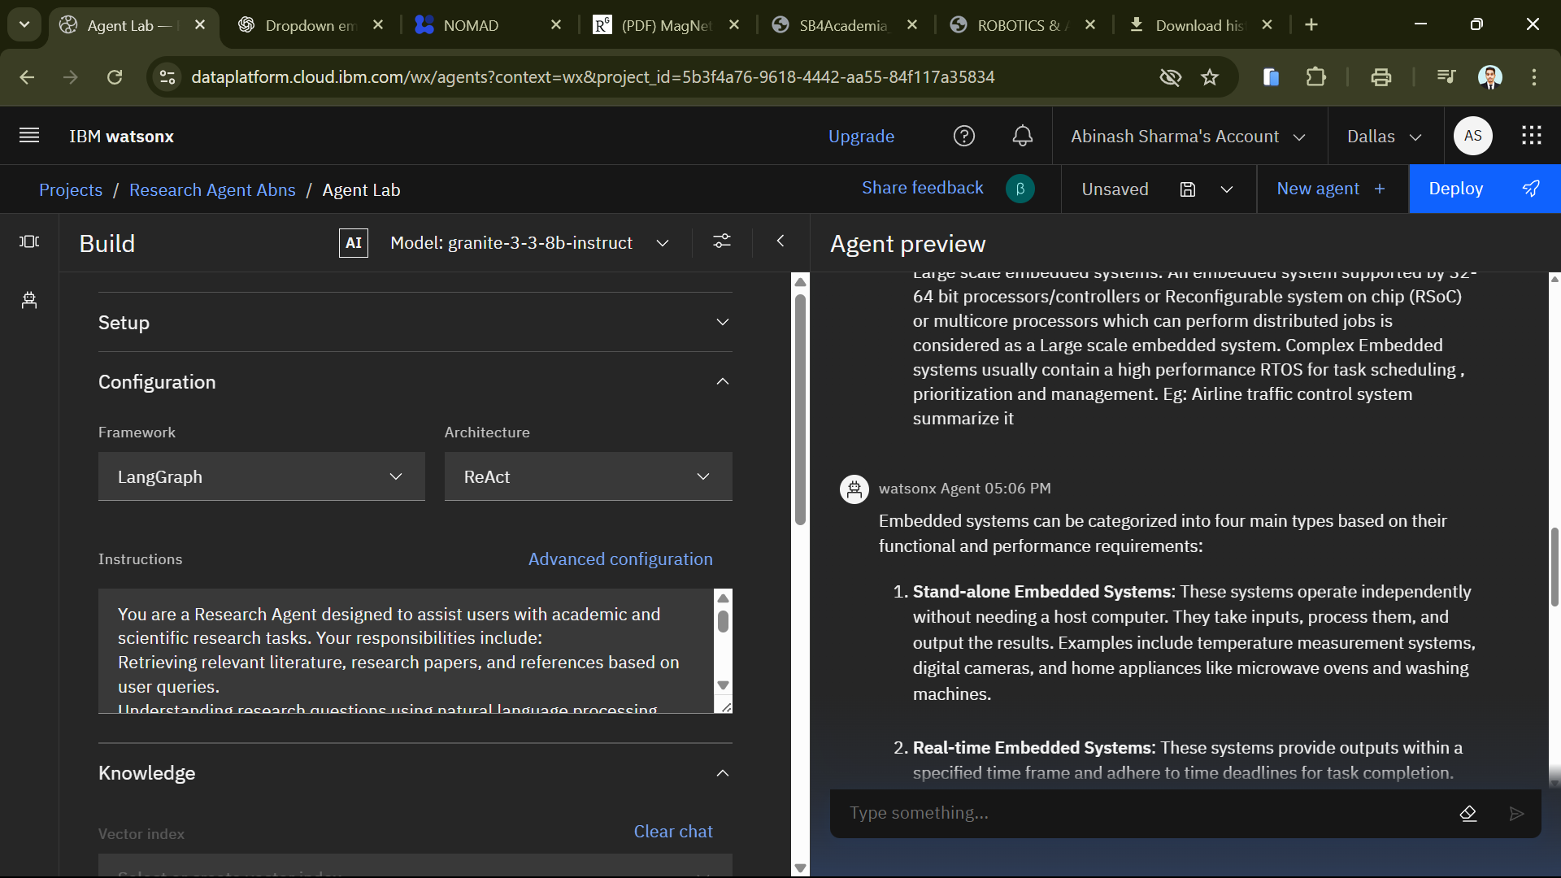
Result

Slide 9
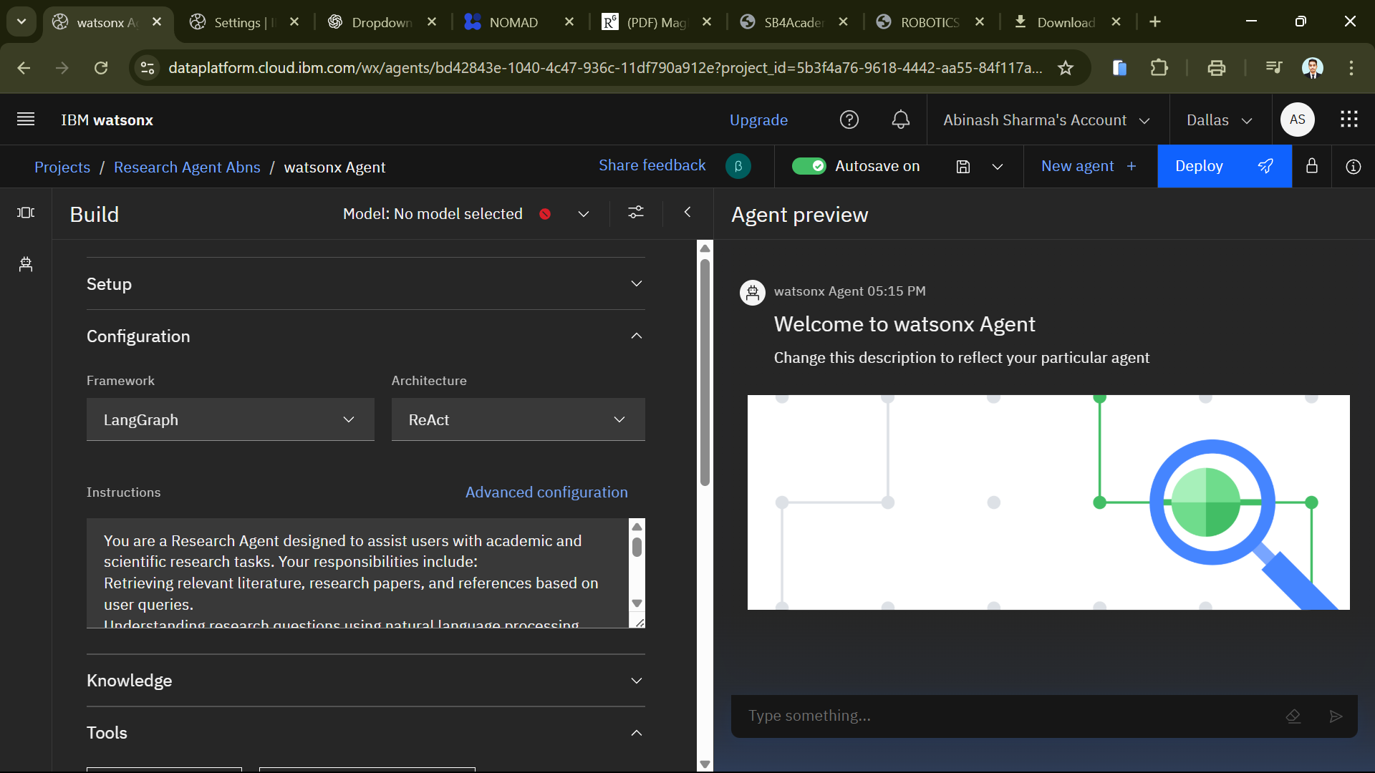
Result

Slide 10
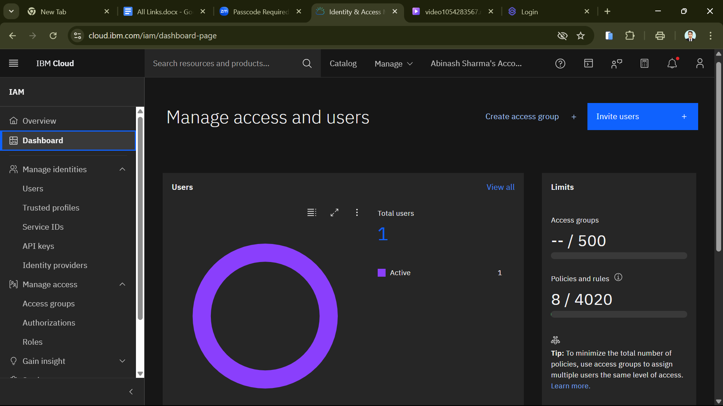
Result

Slide 11
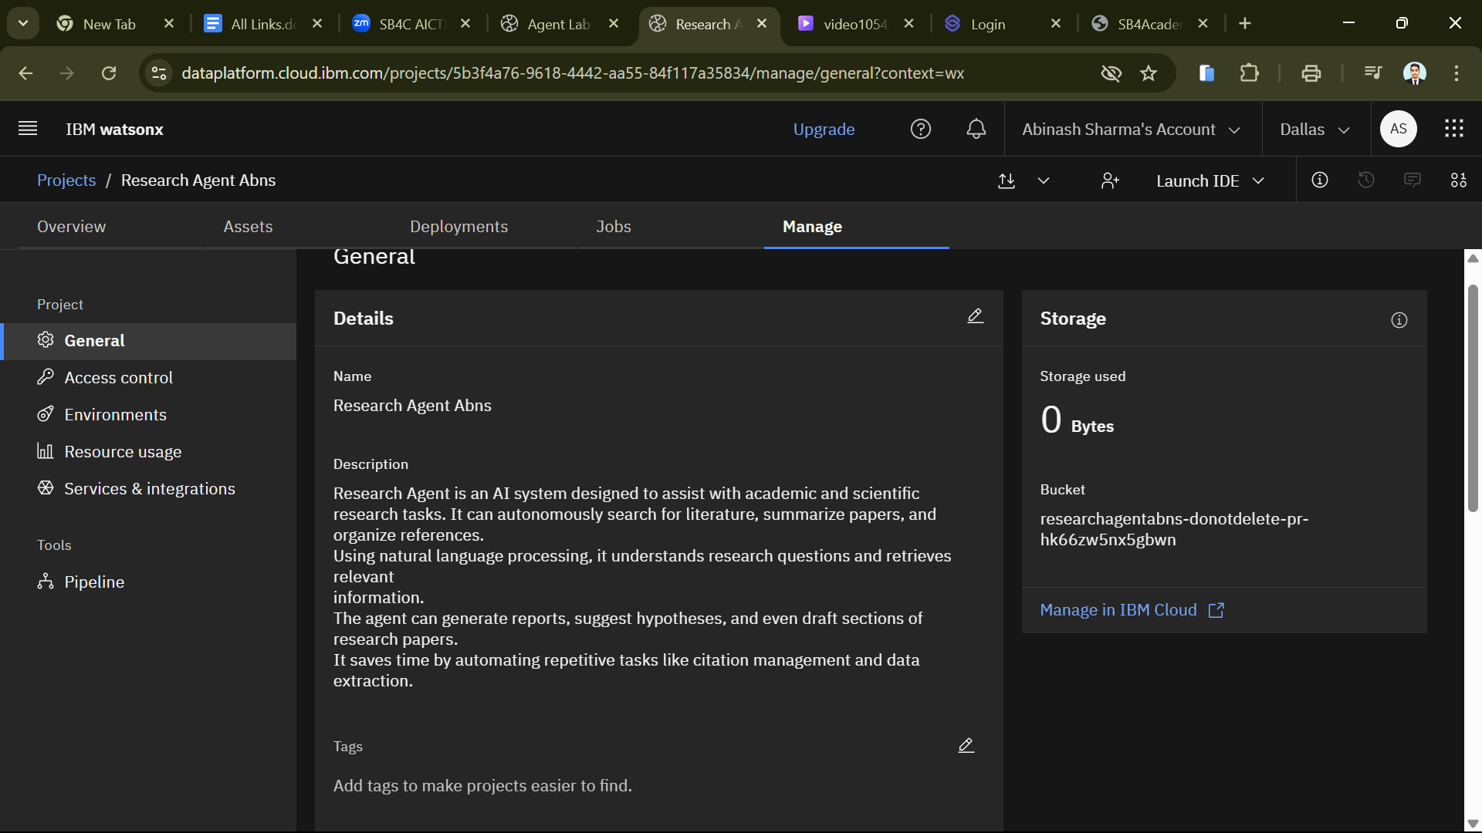
Result

Slide 12
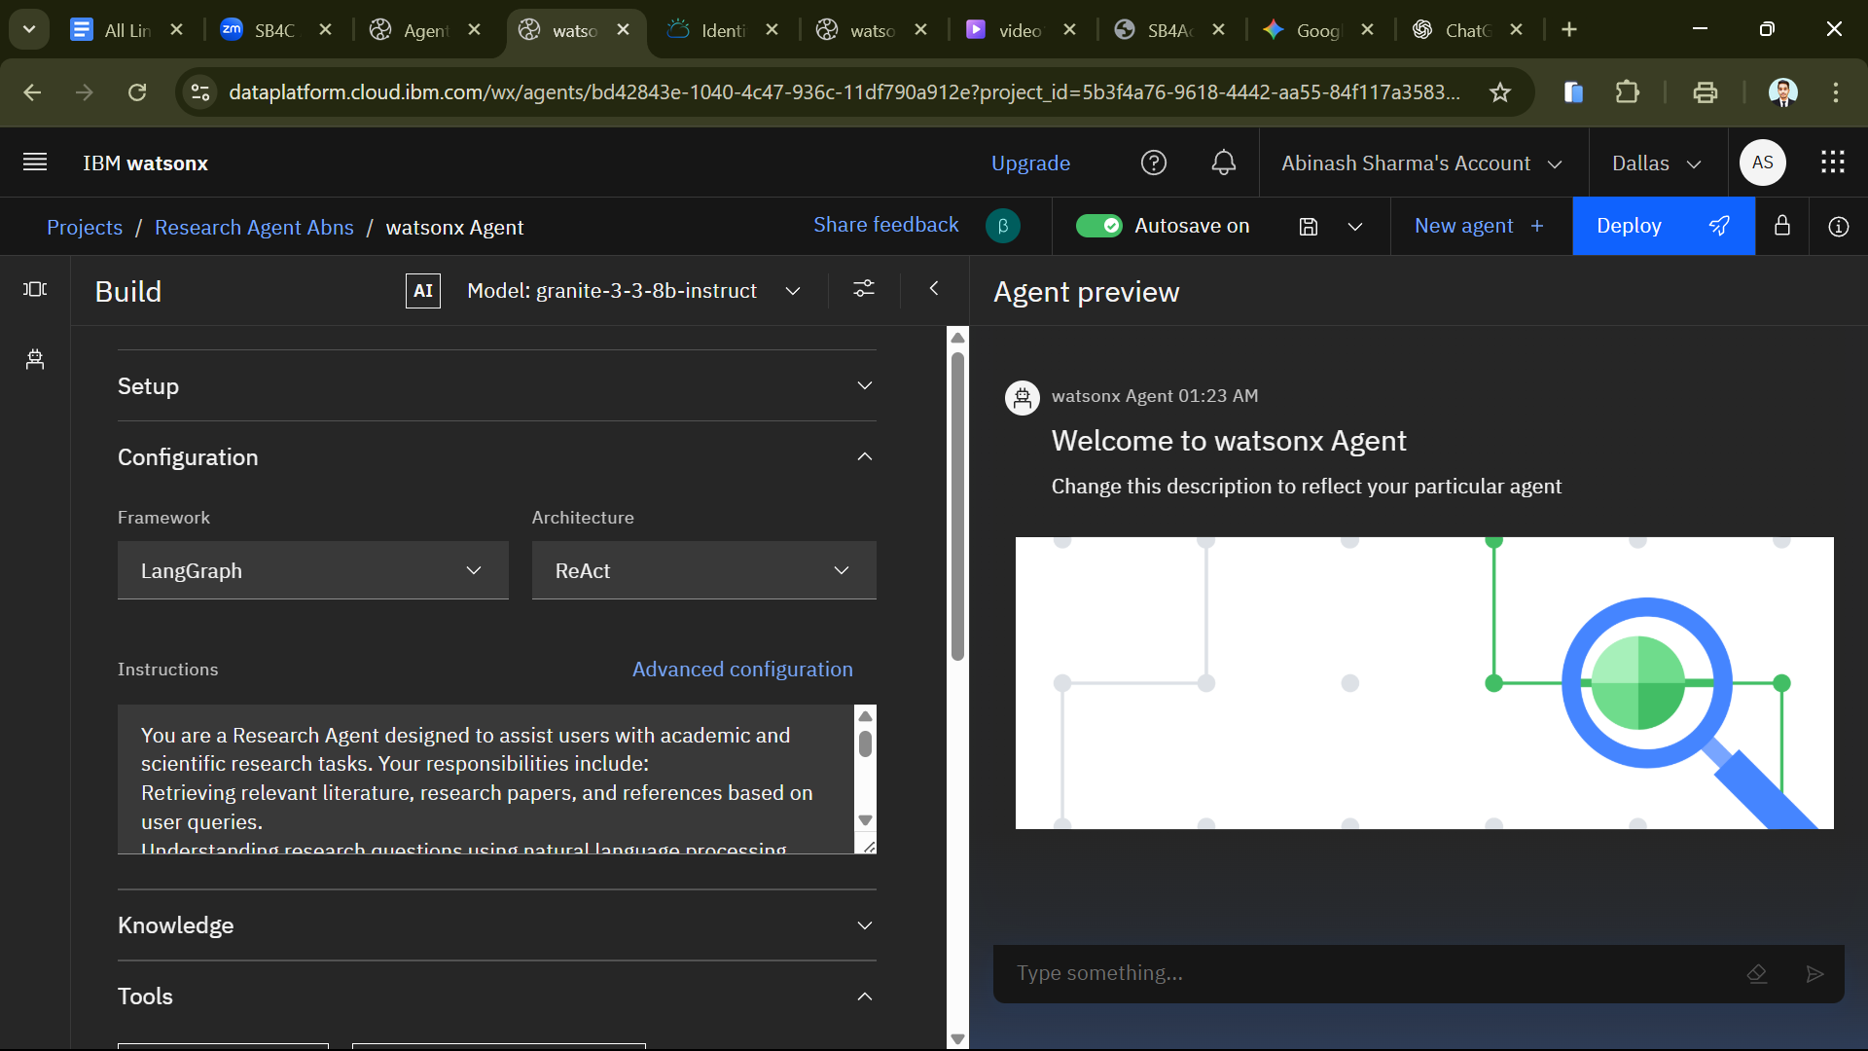
Result

Slide 13
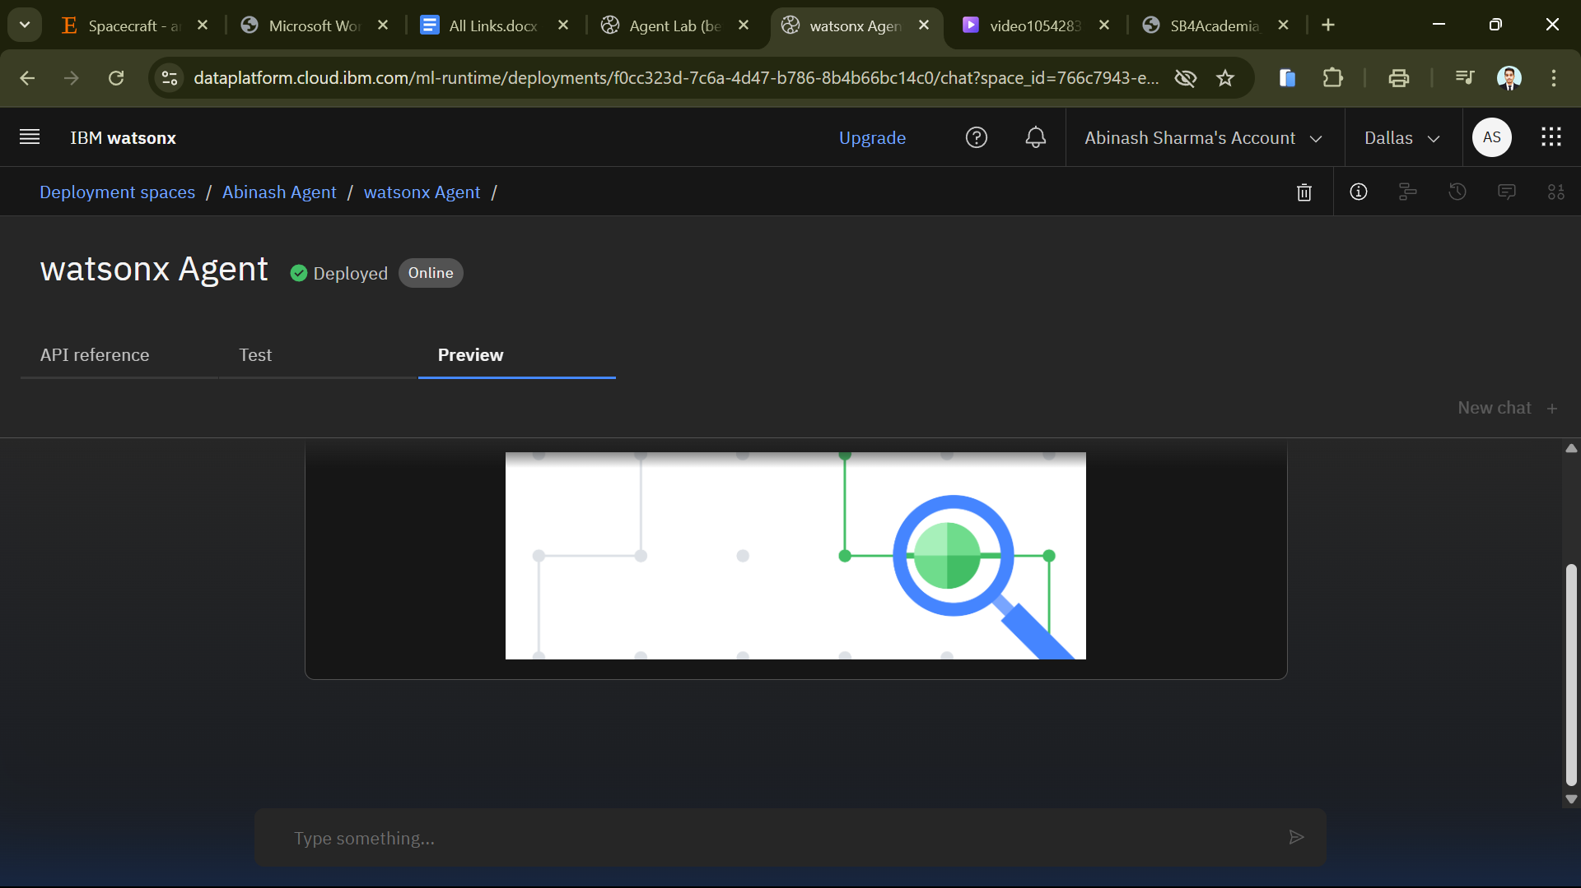
Result

Slide 14
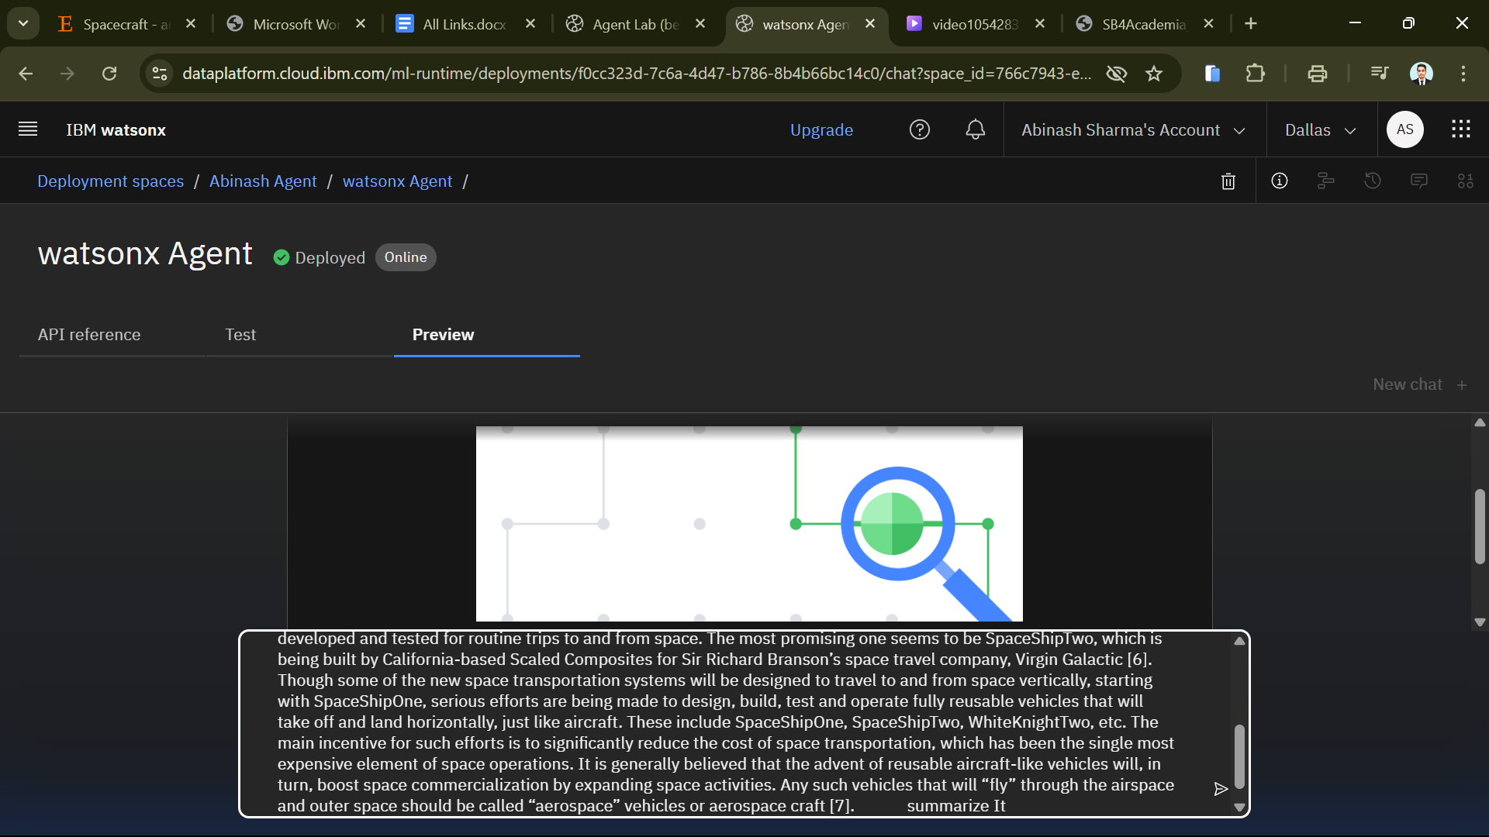
Result

Slide 15
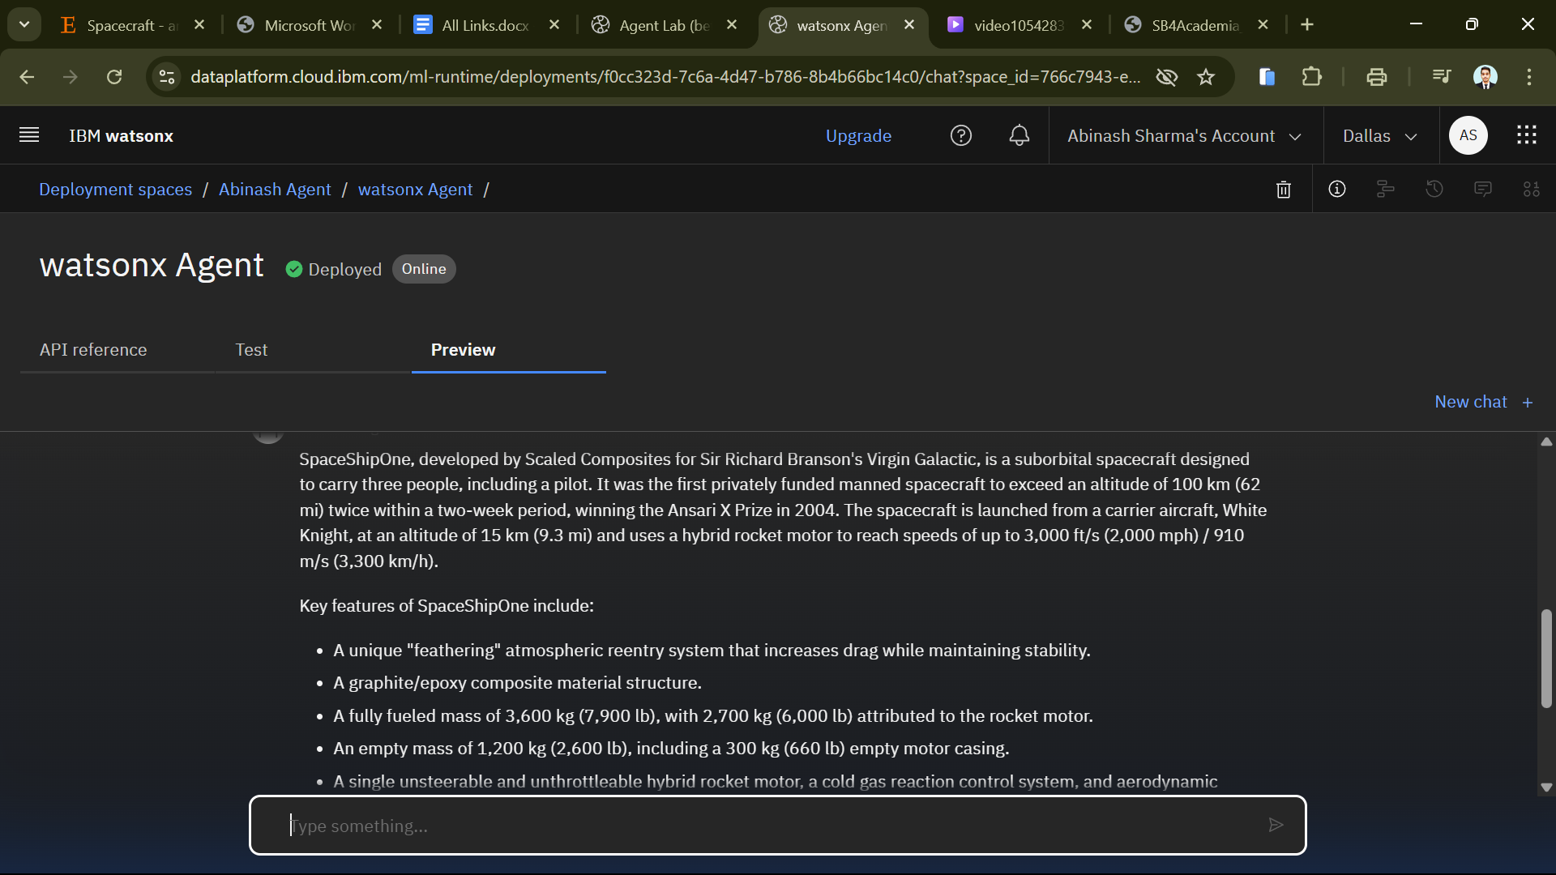
Result

Slide 16
Conclusion
The Research Agent effectively automates the process of literature search, summarization, and reference management, significantly reducing the time researchers spend on repetitive tasks.
By leveraging IBM Cloud Lite services and IBM Granite models, the system ensures accurate and context-aware responses suitable for academic and industrial R&D.
During development, challenges included data preprocessing for diverse document formats and optimizing semantic search accuracy.
These were addressed by implementing vector embeddings and RAG-based retrieval mechanisms.
This solution demonstrates the potential of AI-driven agents to transform research workflows, improving efficiency, accuracy, and innovation. Future enhancements can include multi-language support, integration with more academic databases, and real-time collaboration features for research teams.

Slide 17
Future scope
The Research Agent can be enhanced and expanded in several ways to improve functionality and scalability:
Incorporation of Additional Data Sources
Integrate more academic databases (IEEE, PubMed, Springer) for broader coverage.
Enable real-time web crawling for the latest research publications.
Algorithm Optimization
Fine-tune IBM Granite models for domain-specific research areas.
Improve semantic search accuracy using hybrid retrieval techniques.
Multi-Language & Cross-Domain Support
Extend summarization and search to support multiple languages.
Adapt the system for cross-disciplinary research queries.
Scalable Deployment
Expand deployment to handle larger datasets and concurrent users.
Implement edge computing for faster response in distributed research environments.
Integration with Emerging Technologies
Combine with advanced ML techniques like reinforcement learning for adaptive responses.
Incorporate voice-based research assistants for hands-free querying.

Slide 18
References
IBM Watsonx AI Documentation – https://www.ibm.com/watsonx
IBM Granite Model Overview – https://www.ibm.com/granite
LangChain & LangGraph Documentation – https://python.langchain.com
Lewis, P. et al. (2020). Retrieval-Augmented Generation for Knowledge-Intensive NLP Tasks. NeurIPS.
Devlin, J. et al. (2018). BERT: Pre-training of Deep Bidirectional Transformers for Language Understanding. NAACL-HLT.

Slide 19
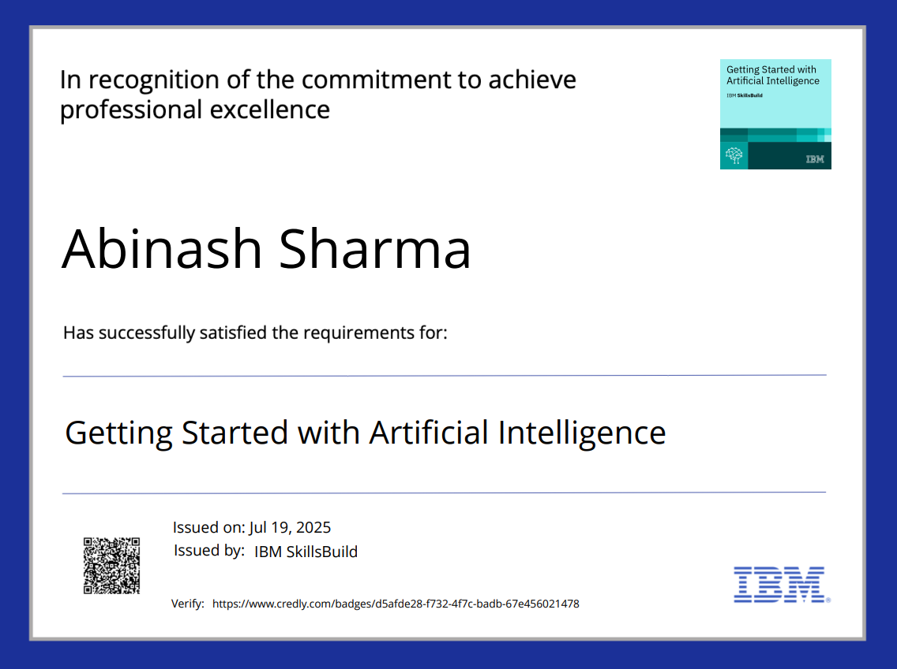
IBM Certifications

Slide 20
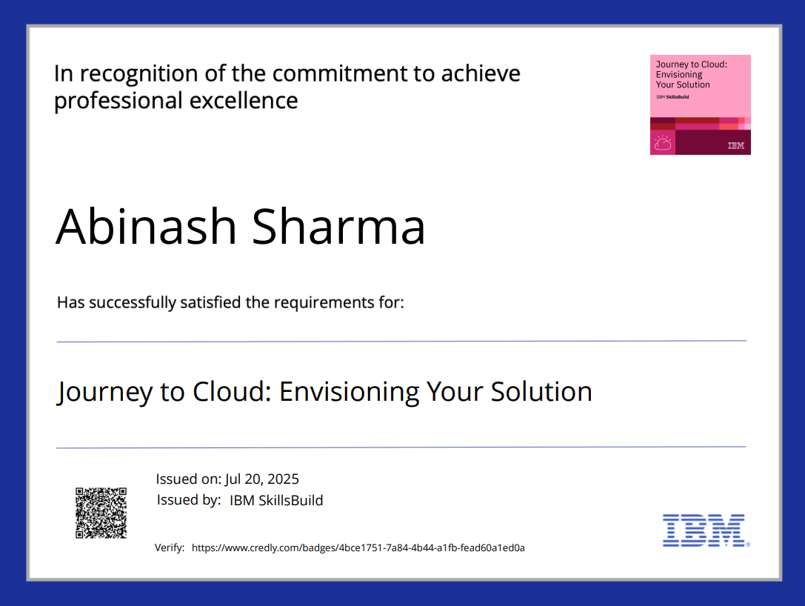
IBM Certifications

Slide 21
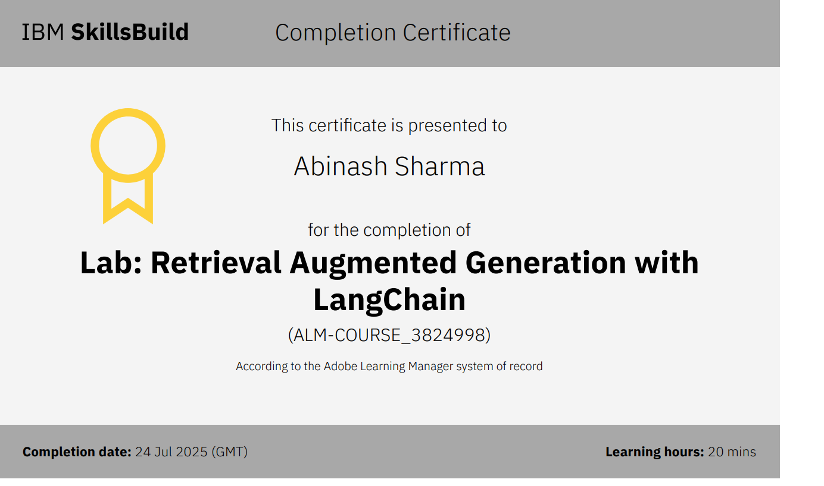
IBM Certifications

Slide 22
THANK YOU

